Slide 1
Unit 2: Electric charge, Voltage & Current
Part A: Electric Charge

Slide 2
What will you learn?
Valence shell, valence electrons and free electrons.
Characteristics of conductors, semi-conductors and insulators.
How electric charges appear to us in the physical world.
How electric charges exist in the atomic level.
Notes:
In this unit, we are introduced to the terms voltage and current

Slide 3


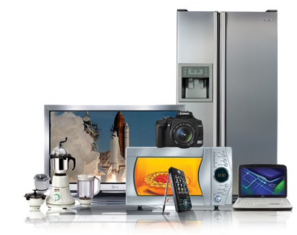
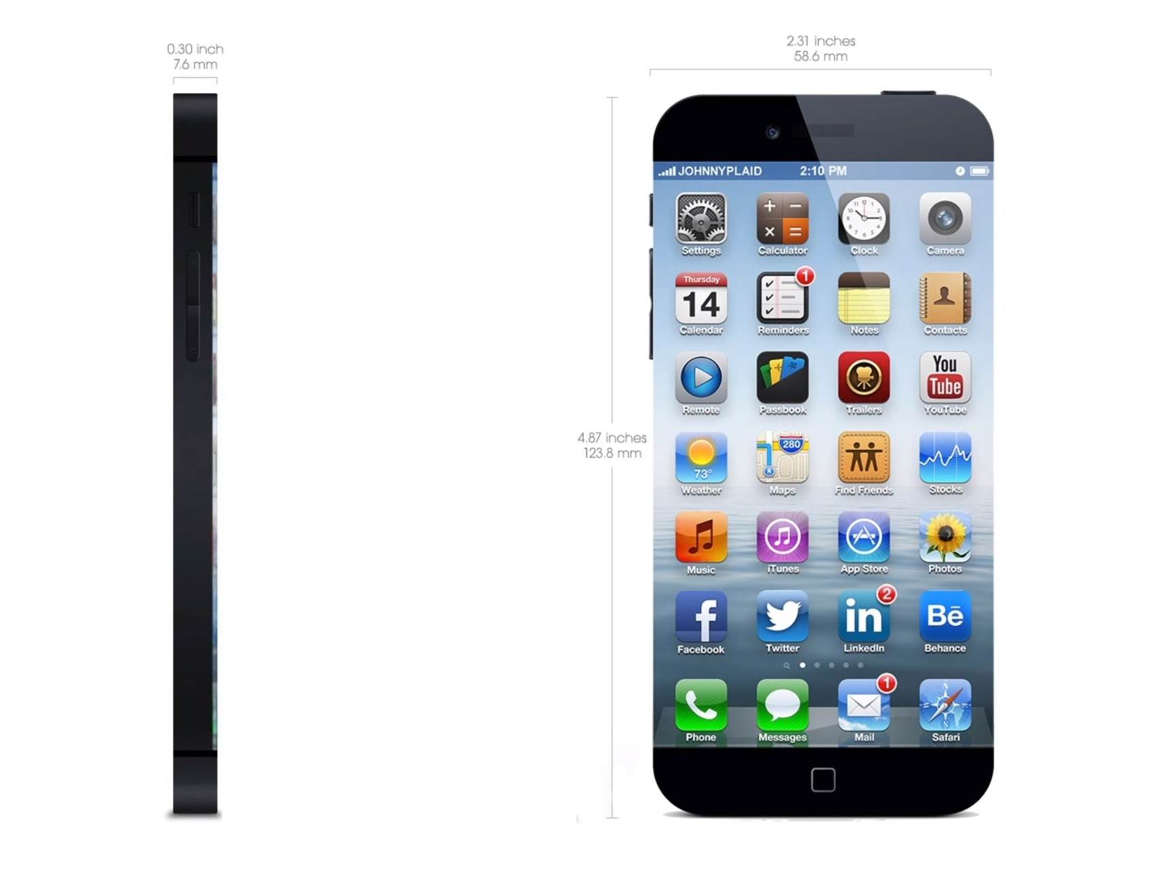
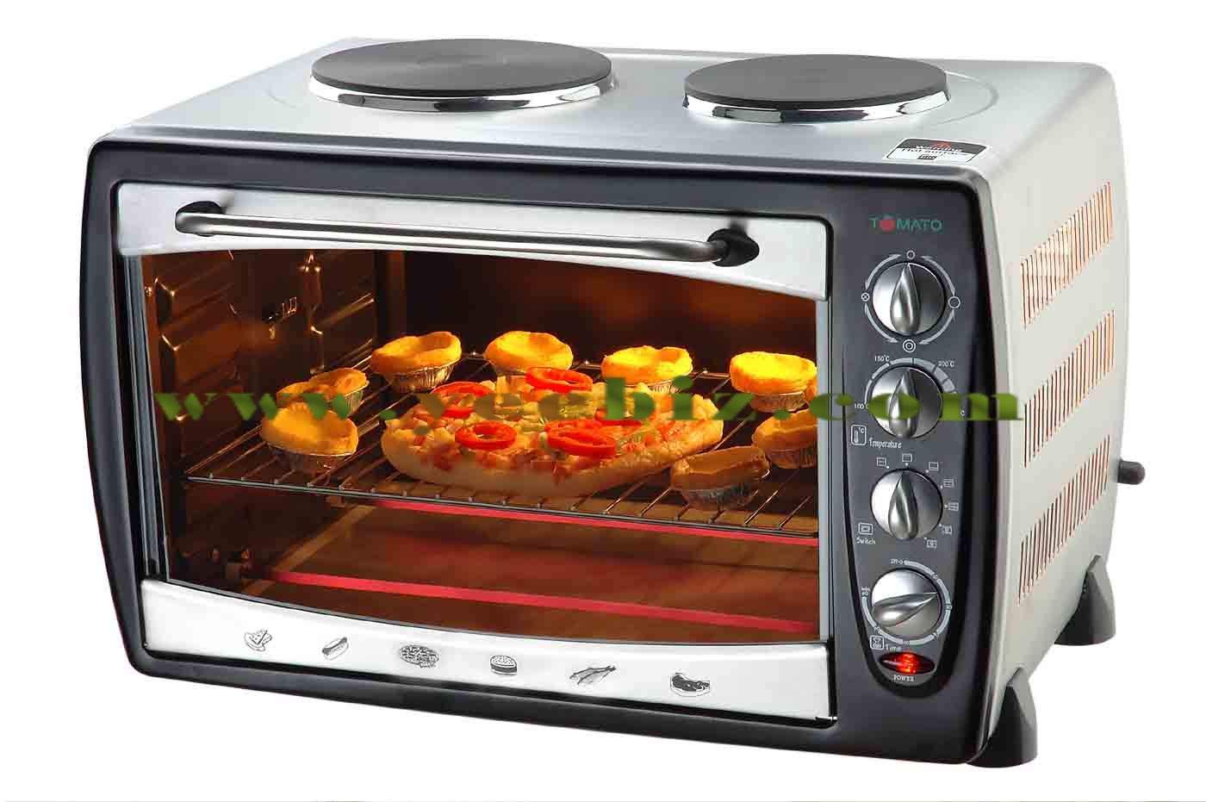
What makes them work?
Notes:
If you look around your environment, you will notice that we are surrounded by a myriad of gadgets. Examples are mobile phones, television, desktop and computers. Our kitchen is equipped with appliances such as the electric kettle, toaster, oven and induction cookers. These are all electrical or electronic appliances or devices. So, what makes these things work?

Slide 4
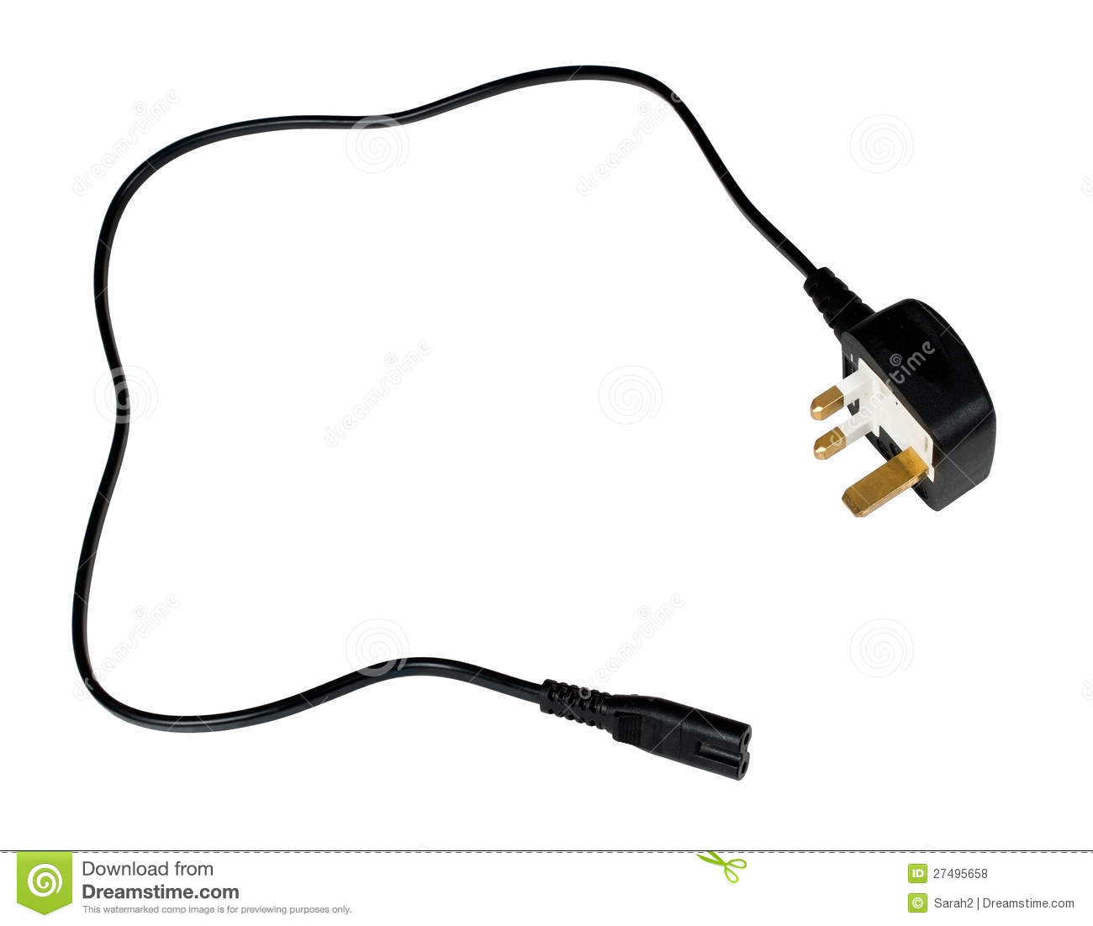
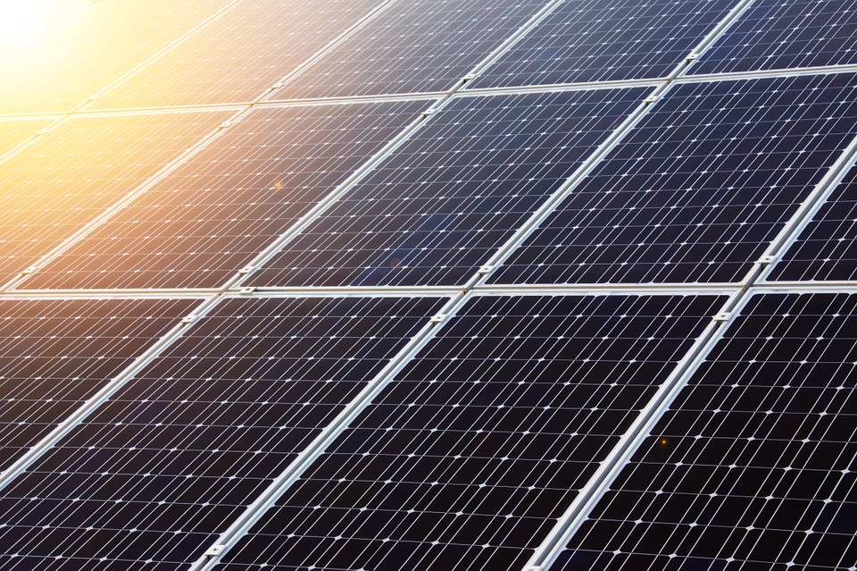
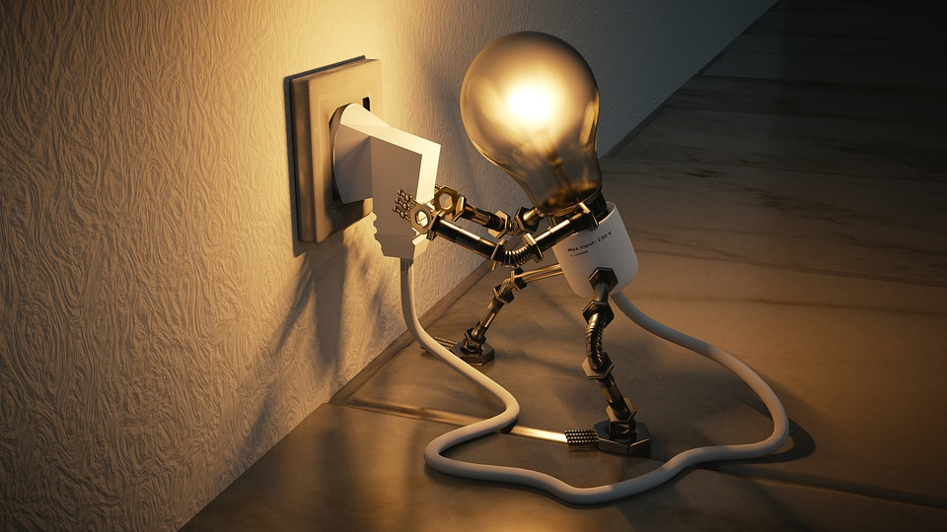

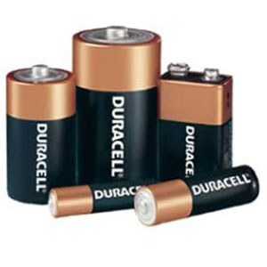
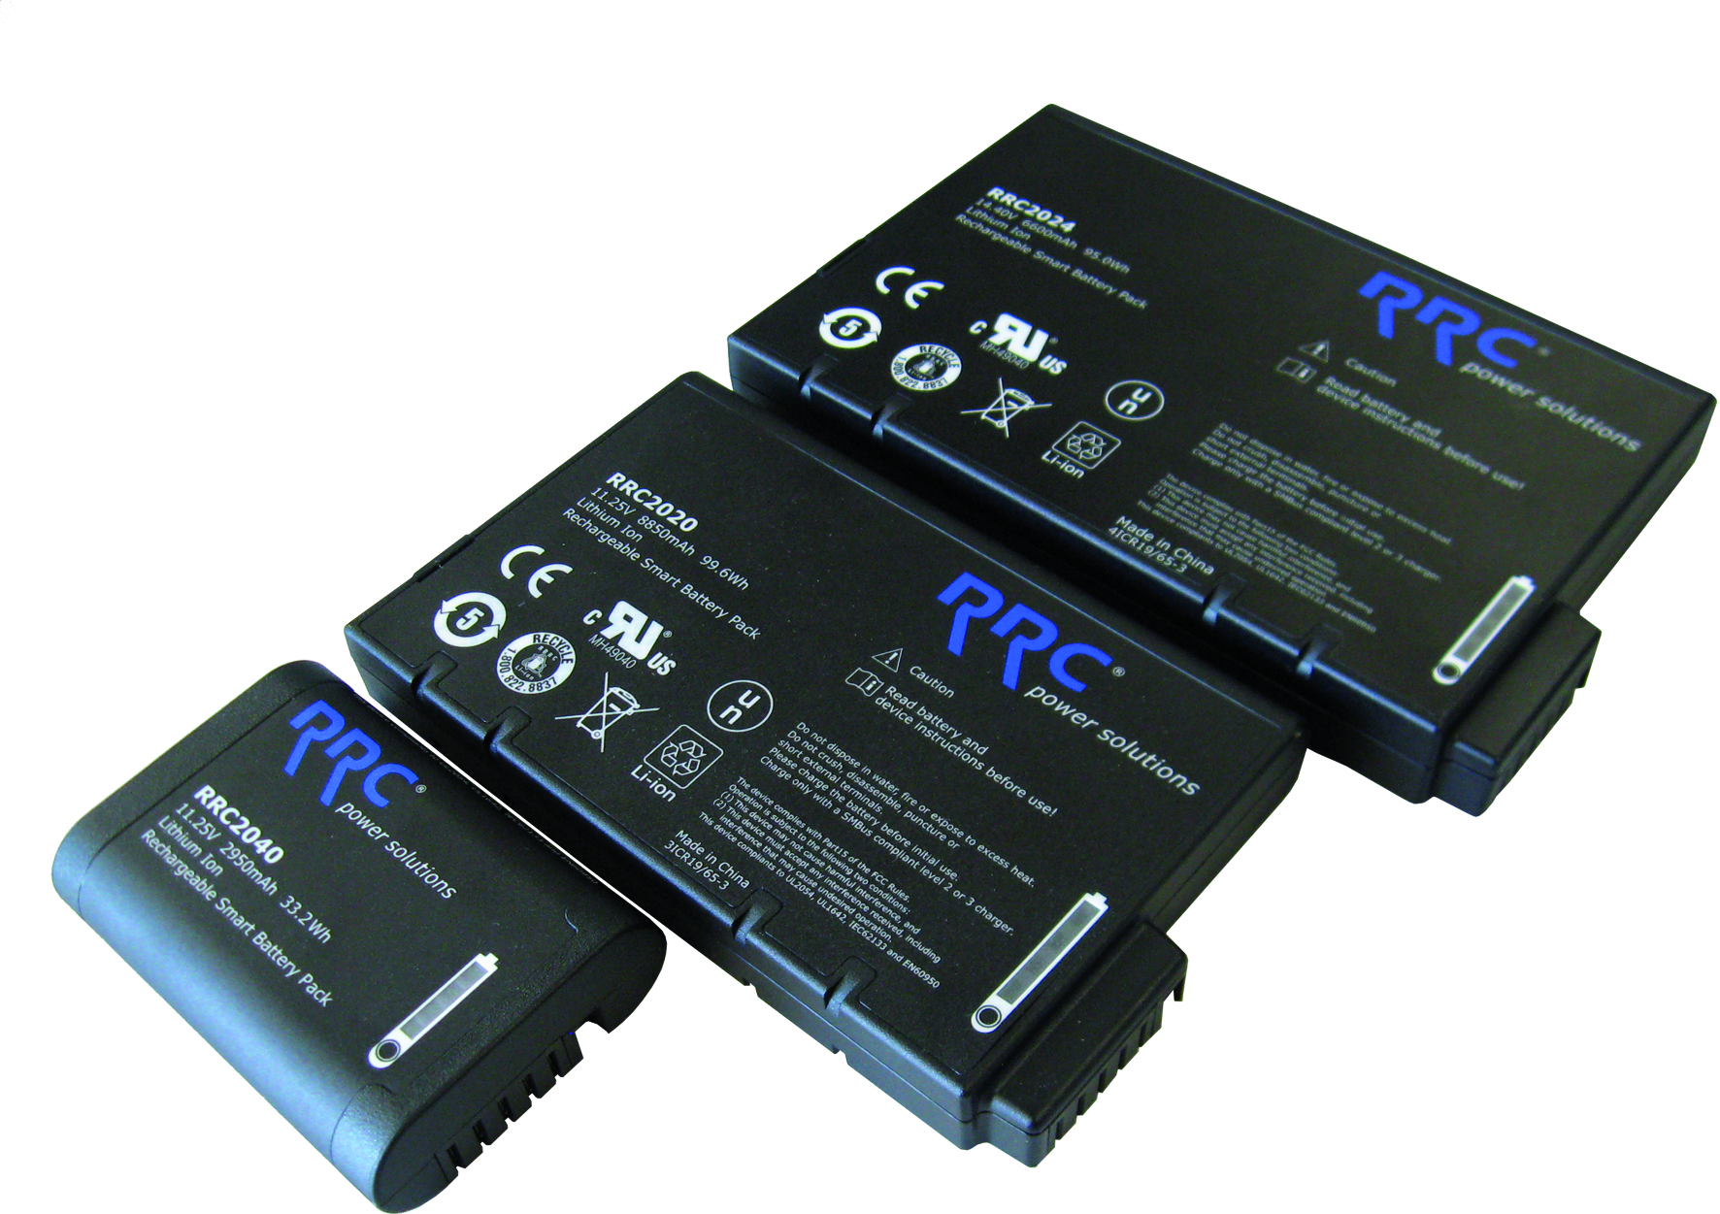
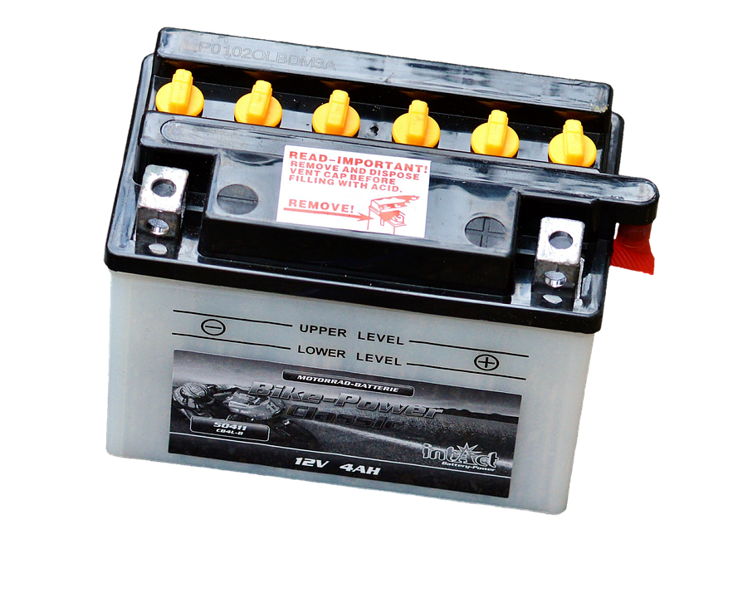
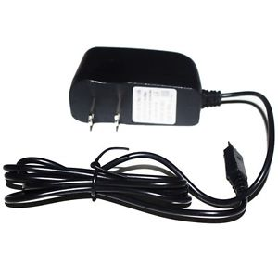
Yes, Power
Notes:
There is one thing in common. They are powered by an electrical energy source either from the wall outlet or from a battery. This electrical energy source is converted to other forms of energy. For example, it is converted to heat when heating up an oven, or light in a television display or sound in music.

Slide 5
Yes, Power
Notes:
There is one thing in common. They are powered by an electrical energy source either from the wall outlet or from a battery. This electrical energy source is converted to other forms of energy. For example, it is converted to heat when heating up an oven, or light in a television display or sound in music.

Slide 6
Unit 2 Outline
Part A: Electric charge
Part B: Voltage
Part C: Current
Notes:
Some of the terminology that we came across in unit one are voltage and current. For example, how do we tell the difference between a larger battery from a smaller one? We use the term voltage. Voltage provides energy to electrons (negative charges), allowing them to move through an electrical circuit. This movement of electrons is called the current. In this unit 2, we will focus on how electric charges are generated and what do the terms voltage and current really mean. Now, we will turn our attention to electric charges.

Slide 7
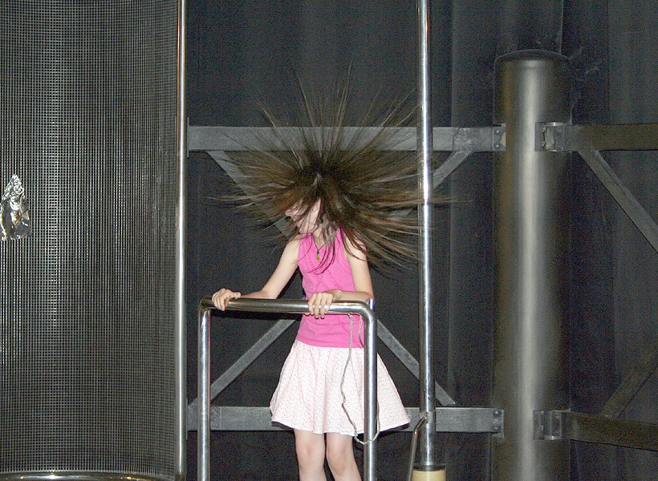
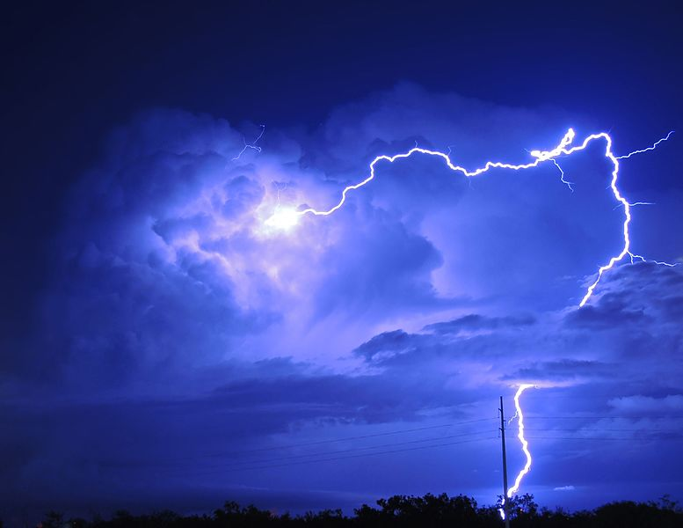
How electric chargers appear to us
"Musée de la découverte, Paris (electrostatics)"
by Jean-noël Lafargue
https://commons.wikimedia.org/wiki/File:Palais_de_la_decouverte_electrostatique_5_jnl.jpg#globalusage
By Mitchel Coombs
https://www.flickr.com/photos/51647007@N08/27663733200/
Notes:
The girl is touching the terminal of a powerful electrostatic generator and is charged with a high electrostatic charge. The strands of her hair repel each other and stand out from her head.
Lightning is a sudden electrostatic discharge that occurs typically during a thunderstorm. This discharge occurs between electrically charged regions of a cloud, between two clouds, or between a cloud and the ground.

Slide 8
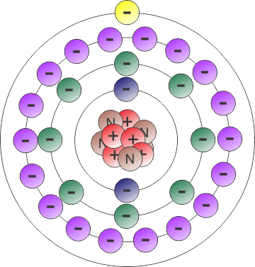
Atomic Structure (Electron Shell Diagram) of Copper
Valence Electron
Notes:
An electric charge comes from an electron which is “freed” from the bonding of the parent atom.
Take copper as an example
A copper atom has a total of 29 electrons orbiting the nucleus and the first three shells each have the maximum number of electrons (2, 8 and 18) for a total of 28. This leaves us with a single electron in the outer shell. This outer shell is also known as a "valence shell".

Slide 9
What are electric charges?
-
Free Electron
Notes:
electrons in the valence shell have a weak attraction to the nucleus and can be easily made to leave their shell and become a free electron. Hence, a free electron is electron that is not attached to an atom, ion or molecule and is free to move under the influence of an electric field.

Slide 10
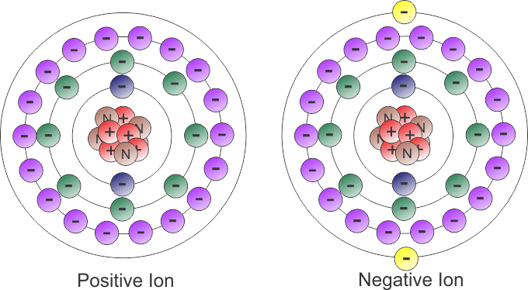
What are electric charges?
Notes:
Atoms will usually have the same number of protons and electrons.
When they are in this state the atom is said to be ""electrically neutral".
The charges of the protons and electrons cancel each other out.
If an atom loses an electron, it will have a higher number of protons and the atom will become positively charged.
Likewise, if an atom gains an electron it will have a negative charge.
Charged atoms are referred to as "ions".
The image below shows the same copper atom, one with a missing electron in the valence shell and the other with an extra electron

Slide 11
Test Yourself
What is a valence electron?
What is a free electron? How is it different from a valence electron?
What materials can facilitate the movement of electric charges?

Slide 12
Student Activity 1
 | Conductor | Insulator | Semiconductor
Conductivity (Ability to allow charge to flow)
Number of free electrons
Number of valence electrons
Give 2 examples

Slide 13
Student Activity 1 - Answers
 | Conductor | Insulator | Semiconductor
Conductivity (Ability to allow charge to flow) | Good | Poor | Neither good nor poor
Number of free electrons | Large number | Very few | Fewer than conductors
Number of valence electrons | Usually less than 4 | Usually more than 4 | Usually 4
Examples | Copper, Aluminium | Oxygen, Nitrogen | Silicon, Germanium

Slide 14
Electric Charge
Electric charges: +ve ions, −ve ions, and electrons.
Quantity of electric charge is represented by Q.
Measured in units of coulombs, C.
Notes:
Free electron is a negatively charged particle
The quantity of electric charge (Q) is measured in Coulombs (C)

Slide 15
Electric Charge
6.25×10¹⁸ electrons carries 1 coulomb of negative charge.
Hence, the amount charge carried by a group of electrons is
Notes:
1 C of negative charge = total charge contained in 6.25 x 10¹⁸ electrons

Slide 16
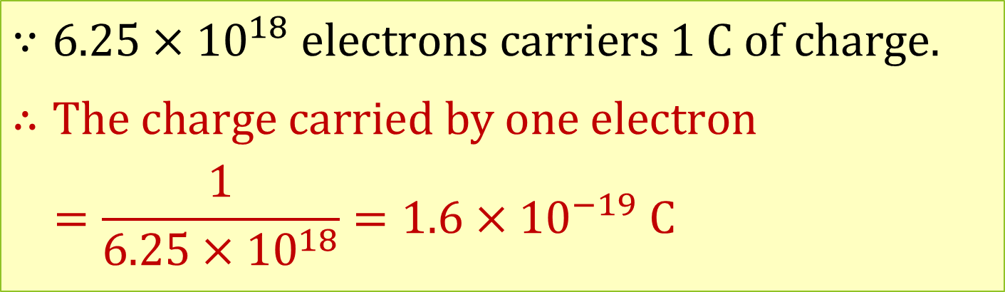
Example 1
Calculate the amount of charge carried by an electron.
$$∵6.25×{10}^{18} electrons carriers 1 C of charge.$$
$$∴The charge carried by one electron$$
$$=\frac{1}{6.25×{10}^{18}}=1.6×{10}^{−19} C$$

Slide 17
Example 2
How much charge is carried by 1.56 × 10¹⁸ electrons?

Slide 18
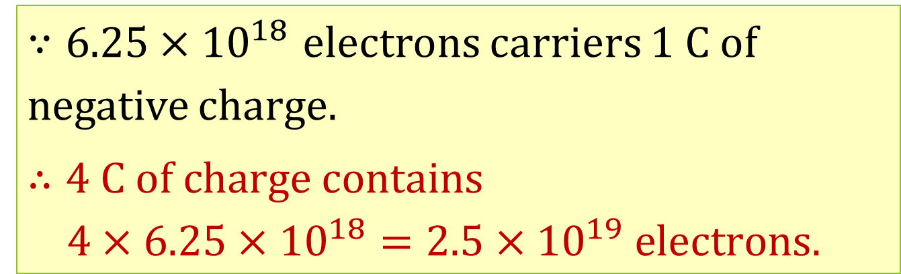
Example 3
How many electrons give 4 C of negative charge?
$∵6.25×{10}^{18}$ electrons carriers 1 C of negative charge.
$$∴4 C of charge contains$$
$$4×6.25×{10}^{18}=2.5×{10}^{19} electrons.$$

Slide 19
What have you learned?
Valence shell, valence electrons and free electrons; and how they are related to conductor, semi-conductor and insulator.
Electric charges are electrons, +ve ions and −ve ions.
Electric charge Q is measured in units of coulombs, C.
6.25×10¹⁸ electrons carries 1 C of charge.

Slide 20
Coming Up Next
In Unit 2 Part B, you will learn about voltage.

